Slide 1
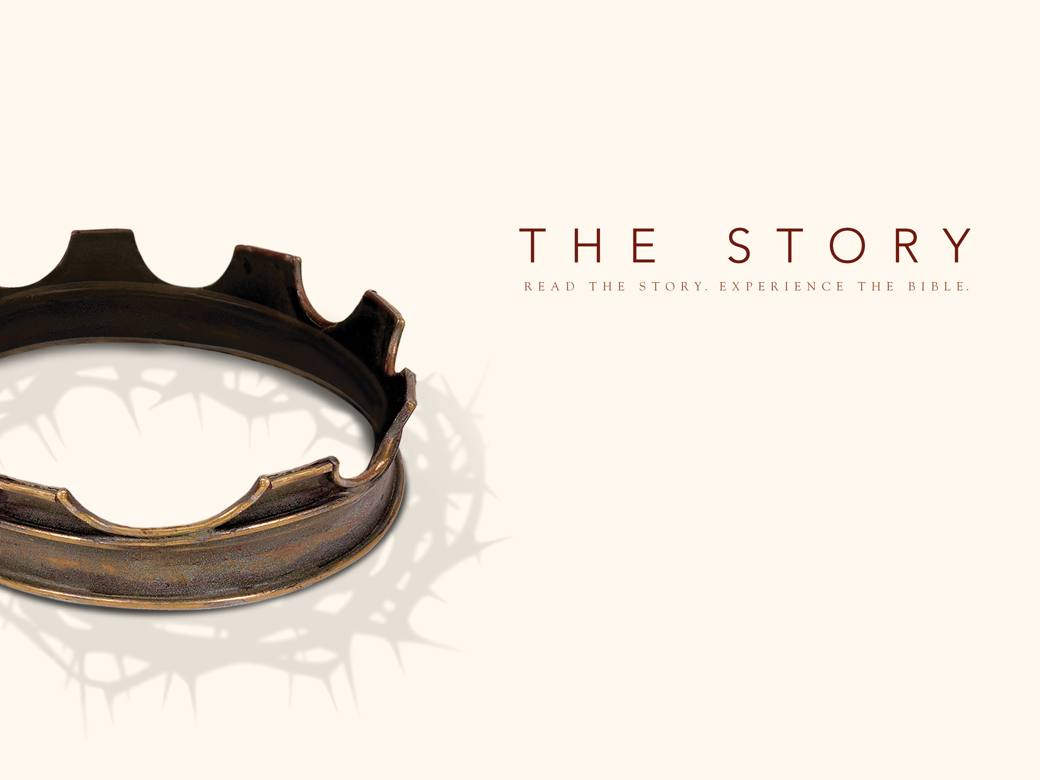
The Big Return!

Slide 2
Ezra 1:1–3 (NIV) In the first year of Cyrus king of Persia, in order to fulfill the word of the Lord spoken by Jeremiah, the Lord moved the heart of Cyrus king of Persia to make a proclamation throughout his realm and also to put it in writing: “This is what Cyrus king of Persia says: “ ‘The Lord, the God of heaven, has given me all the kingdoms of the earth and he has appointed me to build a temple for him at Jerusalem in Judah. Any of his people among you may go up to Jerusalem in Judah and build the temple of the Lord, the God of Israel, the God who is in Jerusalem, and may their God be with them.

Slide 3
Why does God make such a big deal about his temple?
God’s passion: The temple is a picture of God’s passion to dwell among his people.
God’s problem: Sin separates his people and the world from him.
God’s solution: God requires a blood sacrifice so we can regain access to his presence.

Slide 4
Ezra 3:1–3 (NIV) When the seventh month came and the Israelites had settled in their towns, the people assembled together as one in Jerusalem. Then Joshua son of Jozadak and his fellow priests and Zerubbabel son of Shealtiel and his associates began to build the altar of the God of Israel to sacrifice burnt offerings on it, in accordance with what is written in the Law of Moses the man of God. Despite their fear of the peoples around them, they built the altar on its foundation and sacrificed burnt offerings on it to the Lord, both the morning and evening sacrifices.

Slide 5
The people of God return with the task of rebuilding the Temple
The people begin well, but lose focus.
God’s big thing becomes their little thing.
The people abandon the temple for 16 years and begin building their own fine homes.
God’s raises up the prophet Haggai to call the people back to their primary task—building God’s temple.

Slide 6
Haggai 1:1–4 (NIV) In the second year of King Darius, on the first day of the sixth month, the word of the Lord came through the prophet Haggai to Zerubbabel son of Shealtiel, governor of Judah, and to Joshua son of Jozadak, the high priest: This is what the Lord Almighty says: “These people say, ‘The time has not yet come to rebuild the Lord’s house.’ ” Then the word of the Lord came through the prophet Haggai: “Is it a time for you yourselves to be living in your paneled houses, while this house remains a ruin?”

Slide 7
How does God respond to misplaced priorities?
God sends seasons of trial and suffering to call his people to their purpose.
God sends severe times of testing, but not all testing is a result of sin.
God sends trials to wake us up and to exhort us to examine our ways.
God’s people had forgotten their initial passion…
God is either the big-thing or He is no-thing

Slide 8
God will call us from the distractions that pull us from his purpose.
As of a result of seasons of testing, the people of Israel got back on track fulfilling the purpose of God.
Christ calls us to seek FIRST His kingdom and God will take care of everything else.
The prodigal son repented and left the pig pen.
Jonah repented and got out of the fish’s stomach.
The Jews repented and finished the temple for God.

Slide 9
Application
Have you accepted Christ and responded to what He has done for you? OR Are you a Christ Follower who needs to repent and return to your first love, your first passion for God?
Is God speaking to you through a season of testing? Are you listening?
Are you being distracted from God’s purpose for your life? How?
Commit to come back and make God’s priorities your priorities?

